Slide 1
Focus on File Systems Writing pwd
ELEC462003 System Programming

Slide 2






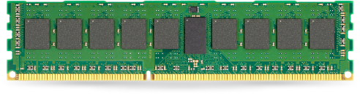
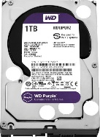



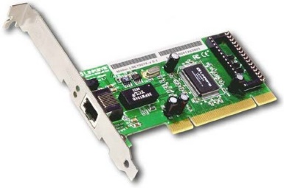

What we will learn ..
Application
(Process)
Application
(Process)
Application
(Process)
Application
(Process)
Application
(Process)
User space
System Call
System Call Interface
Kernel (OS) space
Process
management
memory
management
File systems
I/O
Management
Network
Component
Functionality
Multitasking
Virtual Memory
Files, directories
Device access
Network functionality
Software
Support
Scheduler
Memory
manager
Naming, Access,
Buffering
Character
device driver
Network
Protocol
Hardware
Support
Architecture
-specific code
Block
device driver
Network
Device driver
Hardware Interface
Hardware

Slide 3
Objectives
Ideas and Skills
User’s view of the Unix file system tree
Internal structure of Unix file system: inodes and data blocks
How directories are connected
Hard links, symbolic links: ideas and system calls
How pwd works
Mounting file systems
System Calls and Functions
mkdir, rmdir, chdir
link, unlink, rename, symlink
Commands
pwd

Slide 4
Contents
4.2 User's View of File System
4.3 Internal Structure of Unix File System
4.4 Understanding Directories
4.5 Writing pwd
4.6 Multiple File Systems: A Tree of Trees
Notes:
Users see a file system as a tree of directories, files, and info
A file system is a sequence of disk blocks
A file is a struct of info (an inode) and a list of data blocks
A directory is a list of inode numbers and names
What does it mean for a file to be “in a directory”?
When you log into a Unix machine, you are “in your home directory.”
What does it mean for a person to be “in a directory”?
To answer these questions, we shall write a version of the pwd.

Slide 5

File System ?
A file system is the methods and data structures that an operating system uses to keep track of files on a disk or partition
Aspect of file systems
Space management : The file system is responsible for organizing files and directories and keeping track of which areas of the media belong to which file and which are not being used.
Filenames : used to identify a storage location in the file system.
Directories : allow the user to group files into separate collections.
Metadata : other bookkeeping information (e.g., file size, last modified time, owner ID, etc.) associated with each file within a file system.
Notes:
Users see a file system as a tree of directories, files, and info
A file system is a sequence of disk blocks
A file is a struct of info (an inode) and a list of data blocks
A directory is a list of inode numbers and names
What does it mean for a file to be “in a directory”?
When you log into a Unix machine, you are “in your home directory.”
What does it mean for a person to be “in a directory”?
To answer these questions, we shall write a version of the pwd.

Slide 6
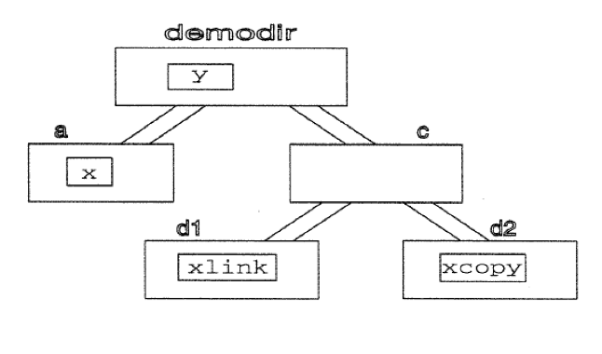
Directories and Files
What users see: one big tree of directories and files
Each directory can contain files or directories.
Notes:
Tree contains files: file info and

Slide 7
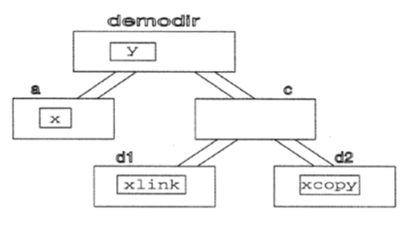
Directory Commands
$ mkdir demodir
$ cd demodir
$ mkdir b oops
$ mv b c
$ rmdir oops
$ cd c
$ mkdir d1 d2
$ cd ../..
$ mkdir demodir/a
mkdir: create a new directory with a specified name
rmdir: removes a directory
mvdir : rename a directory. move a directory from one place to another
cd : move from you from one directory to another
Notes:
$ Is -R
Mv: renames a directory or moves a directory from one place to another
cd
moves you from one directory to another
pwd
prints out the path to the current directory

Slide 8
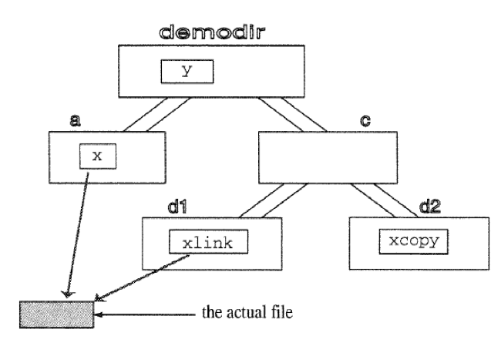
File Commands
$ cd demodir
$ cp /etc/group x
$ cp x copy.of.x
$ mv copy.of.x y
$ mv x a
$ cd c
$ cp ../a/x d2/xcopy
$ ln ../a/x d1/xlink
$ ls > d1/xlink
$ cd ../..
$ cat demodir/a/x
ln : make a link which is a pointer to a file
Notes:
The /etc/group file contains basic group attributes. This is an ASCII file that contains records for system groups. Each record appears on a single line and is the following format:
Name:Password:ID:User1,User2,...,Usern
You must separate each attribute with a colon. Records are separated by new-line characters. The attributes in a record have the following values:
AttributeDescriptionNameSpecifies a group name that is unique on the system. See the mkgroupcommand for information on the restrictions for naming groups.PasswordNot used. Group administrators are provided instead of group passwords. See the /etc/security/group file for more information.IDSpecifies the group ID. The value is a unique decimal integer string. The maximum value is 4,294,967,295 (4 GB).User1,User2,...,UsernIdentifies a list of one or more users. Separate group member names with commas. Each user must already be defined in the local database configuration files.
We use the > symbol to redirect the output of a command to a file.
ln ../a/x d1/xlink
take an existing file, ../a/x and make a link to it, d1/xlink.
Both x and xlink are called links
ls > d1/xlink
replaces the contents of the xlink file with the output of ls.
A link is a pointer to a file : ../a/x and d1/xlink point to the same data on the disk
-----------------
cp
makes a copy of a file
cat
copies the contents of the file to standard output
mv
renames a file or moves a file to a different directory
rm
deletes a file

Slide 9
Unix Commands operate on entire tree structure
ls –R
Lists the contents of the specified directory and all its subdirectories
Ex) $ ls –R demodir/
chmod –R
Changes the permission bits of files in applying the changes to all files in subdirectories.
Ex) $ chmod -R 755 directory-name/
Notes:
Cmds operate on entire tree structure
ls –R
Lists the contents of the specified directory and all its subdirectories
chmod –R
Changes the permission bits of files in applying the changes to all files in subdirectories.
du : disk usage
find
Searches a directory and all its subdirectories for files and directories that match a description specified on the command line.

Slide 10
Summary of the User’s View of the UNIX File System
The disk appears as a tree structure of directories
All files on a Unix system reside in this structure
Unix includes many programs for working with the objects of this structure
Notes:
Cmds operate on entire tree structure
ls –R
Lists the contents of the specified directory and all its subdirectories
chmod –R
Changes the permission bits of files in applying the changes to all files in subdirectories.
du : disk usage
find
Searches a directory and all its subdirectories for files and directories that match a description specified on the command line.

Slide 11
Contents
4.2 User's View of File System
4.3 Internal Structure of Unix File System
4.4 Understanding Directories
4.5 Writing pwd
4.6 Multiple File Systems: A Tree of Trees

Slide 12
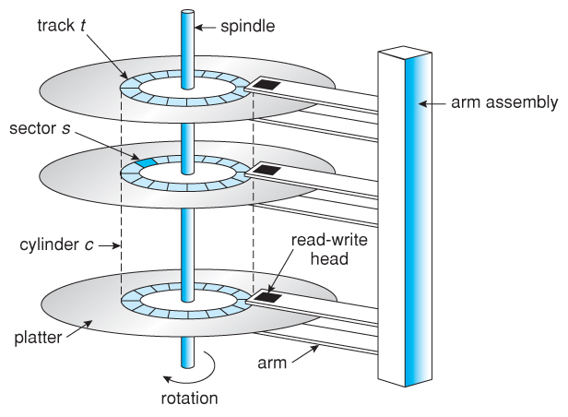
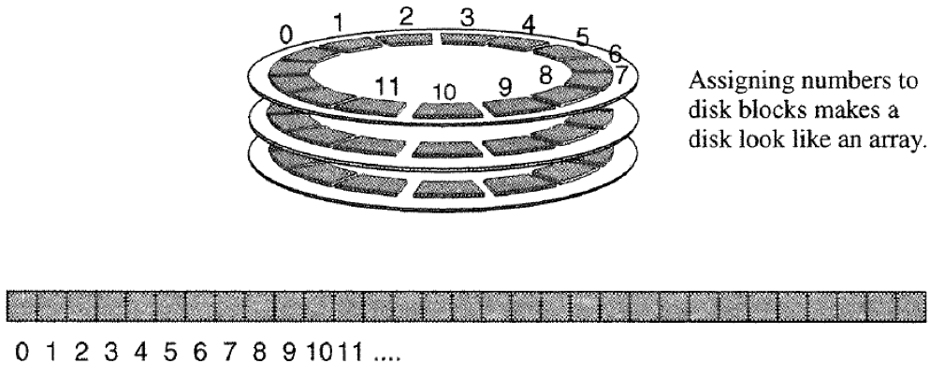
From Platters to an Array of Blocks
A disk is a stack of magnetic platters
Each platter is organized into tracks
Track is divided into sectors that is the smallest physical storage unit on disk. Each sector stores some number of bytes (ex: 512 bytes)
A block is a group of sectors that the operating system can address. A block might be one sector or it might be several sectors
Assigning numbers to the blocks makes a disk look like an array
Notes:
A disk is really a stack of magnetic platters.
A few levels of abstraction convert the stack of platters into the file system
Sector is the basic unit of storage on the disk
fixed size. ex) 512 bytes for HDD, etc.
A numbering system for disk sectors lets us treat a disk as an array of blocks
How can a numbered sequence of blocks store files, file info, and directories?

Slide 13
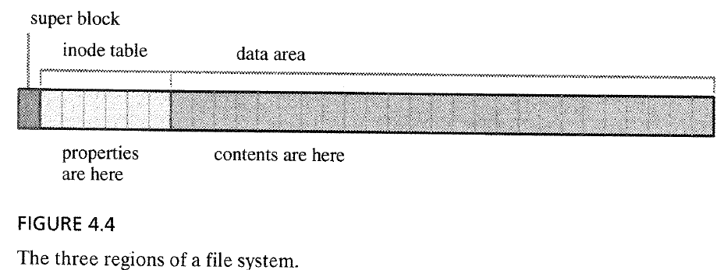
From an Array of Blocks to Three Regions
Divide the array of blocks into tree sections:
Superblock
inode Table
Data Area (Data blocks)
inode Table
Data blocks
Super block
Notes:
superblock
Contains information about the organization of the file system itself.
The size of each area, the location of unused data blocks, etc.
The exact contents and structure depend on the version of Unix.
inode table
An array of structs called inodes.
The properties of a file are recorded in an inode.
size, user ID of the owner, time of last modification, etc.
Each of files has one inode in the table.
Each inode is identified by its position in the table.
Ex) inode 2 is the third struct in the inode table
A directory is a table of form: inum filename

Slide 14
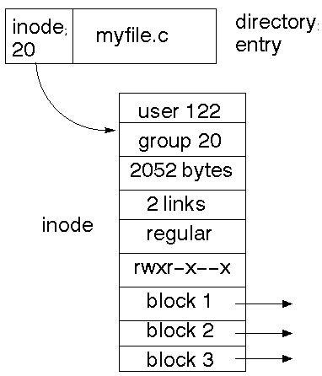
From an Array of Blocks to Three Regions
Divide the array of blocks into tree sections:
Superblock
Contains information about the organization of the file system
Ex) size of each area, location of unused data block
inode Table : an array of inodes.
inode : a structure containing the properties of a file such as size, user ID of the owner, the time of last modification.
Every file stored in the file system has one inode in the table
Each inode is identified by its position (e.g., inode 2 is the third structure in the inode table of the file system)
Data Area (Data blocks)
Contains contents of files
If a file is larger than a block size, the contents of the file are stored in as many blocks as are needed.
Notes:
superblock
Contains information about the organization of the file system itself.
The size of each area, the location of unused data blocks, etc.
The exact contents and structure depend on the version of Unix.
inode table
An array of structs called inodes.
The properties of a file are recorded in an inode.
size, user ID of the owner, time of last modification, etc.
Each of files has one inode in the table.
Each inode is identified by its position in the table.
Ex) inode 2 is the third struct in the inode table
A directory is a table of form: inum filename

Slide 15
inode
inode
inode: for storing file metadata
One inode block for each file
inode number
used to index into the inode table
Information in the inode
file type (regular, directory, symbolic link, char dev)
owner
group
access permission for owner, group and other
time stamps: last access, modification, status change time (i-node change)
# of hard links to the file
size of file in bytes
# of blocks allocated to the file
pointers to the data blocks
file1
file2
(hard-linked)
sym link

Slide 16
File System in Practice: Creating a File
Create a file : $ who > userlist
What happens when the userlist file is created?
Store properties: Kernel allocates a free inode and records the properties in the inode
Store data: Kernel allocates free blocks and copies file data from kernel buffers into the allocated blocks
Record allocation: Kernel records the sequence of the allocated block numbers in the disk allocation section of the inode
Add filename to directory: Kernel adds an entry (a pair of the inode number and filename) to the directory for the file

Slide 17
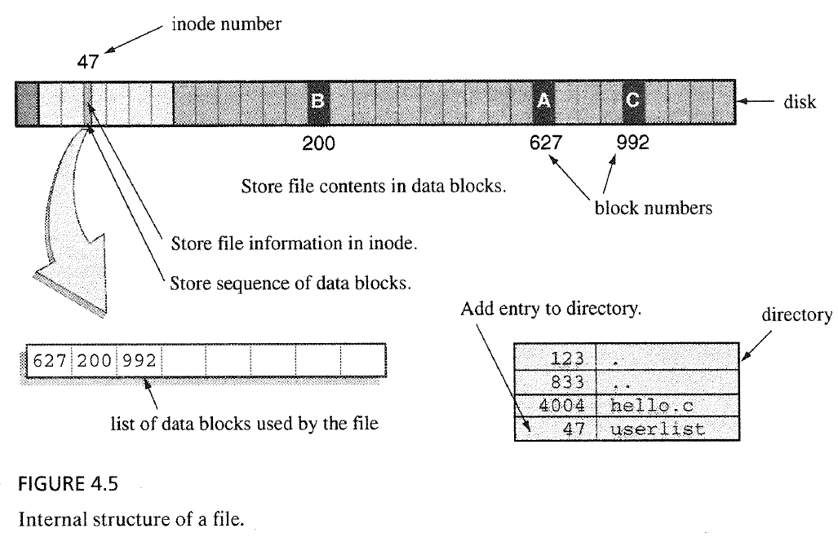
File System in Practice: Creating a File
Create a file : $ who > userlist
What happens when the userlist file is created?
allocation list of the blocks used by the file

Slide 18
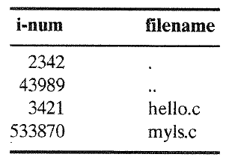
File System in Practice: How Directories Work
Internal structure of directory
Directory is a kind of file that contains a list of names of files
The internal structure of directory is a kind of table that contains pairs of inode number and filename
We can find the inode numbers of files with “ls -i” command
The filename y refers to inode number 204491 which means that the properties of the file is stored in 204492th inode in the inode table
Notes:
The inum locates the inode

Slide 19
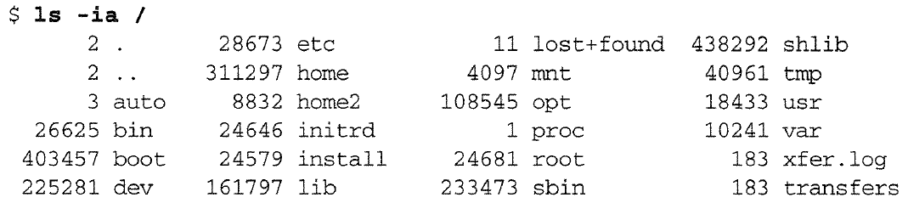
File System in Practice: How Directories Work
There can be multiple links to the same file
“xfer.log” and “transfers” refer to the same inode → they are two names for the same file.
For the root directory (/) , “.” and “..” refer to the same inode
→ they refer to the same directory
How?
When unix command mkfs creates a file system, mkfs sets the parent of the root directory to point to itself
Notes:
When unix command mkfs creates a file system, mkfs sets the parent of the root directory to point to itself:
.
..

Slide 20
File System in Practice: How “cat” Works
Read a file : $ cat userlist
What happen when you read a file?
Search the directory for the filename: Kernel searches the directory for the entry containing the string userlist and get the associated inode number from the entry
Read inode and get a list of data blocks: Kernel locates the corresponding inode with the inode number in inode region of the file system, and get a list of data blocks
Locating an inode requires a simple calculation, because all inodes are the same size and each block contains a fixed number of inodes
Go to the data blocks and read contents: Kernel steps through the data blocks, copying bytes from the disk to the kernel buffers and back to the array (buffer) in user space
Notes:
As cat repeatedly calls read, the kernel steps through the data blocks,
copying bytes from the disk to the kernel buffers and back to the array in user space.

Slide 21
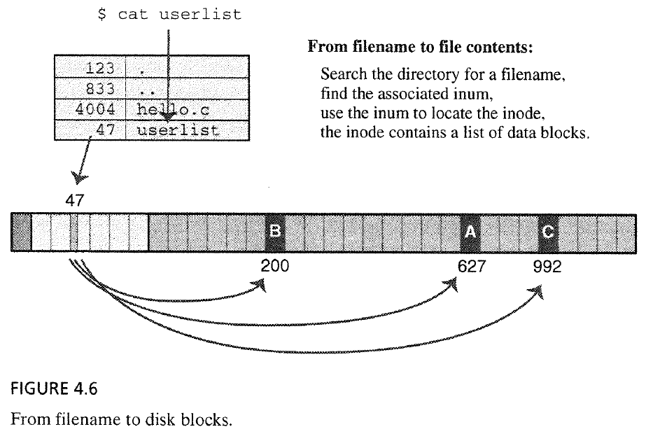
File System in Practice: How “cat” Works
Read a file : $ cat userlist
What happen when you read a file?
Notes:
As cat repeatedly calls read, the kernel steps through the data blocks,
copying bytes from the disk to the kernel buffers and back to the array in user space.

Slide 22
File System in Practice: How “cat” Works
What happen when you attempt to open a file that you do not have read or write permission?
Kernel uses the filename to find the inode number
Kernel uses the inode number to locate the inode
Kernel finds the permission bits and the user ID of the owner of the file
If your user ID, the ower ID of the file, and the permission bits do not allow access, then the “open()” system call returns -1 and sets errno to EPERM.
Notes:
As cat repeatedly calls read, the kernel steps through the data blocks,
copying bytes from the disk to the kernel buffers and back to the array in user space.

Slide 23
inodes and Big Files
Situation
A large file requires many blocks
The inode stores an allocation list of the blocks
Problem
How can a fixed-sized inode store a long allocation list?
Solution: store most of the allocation list in data blocks and leave pointers to those blocks in the inode
Say, an inode has an allocation array with only 13 spots and we want to store a list of 14 block number
Put the first 10 block numbers in the allocation array of the inode
Put the last 4 numbers in a block placed in the data area
The block number of the block holding the extra 4 block numbers is stored in the 11th spot in the inode
indirect block : block that contains the part of the allocation list

Slide 24
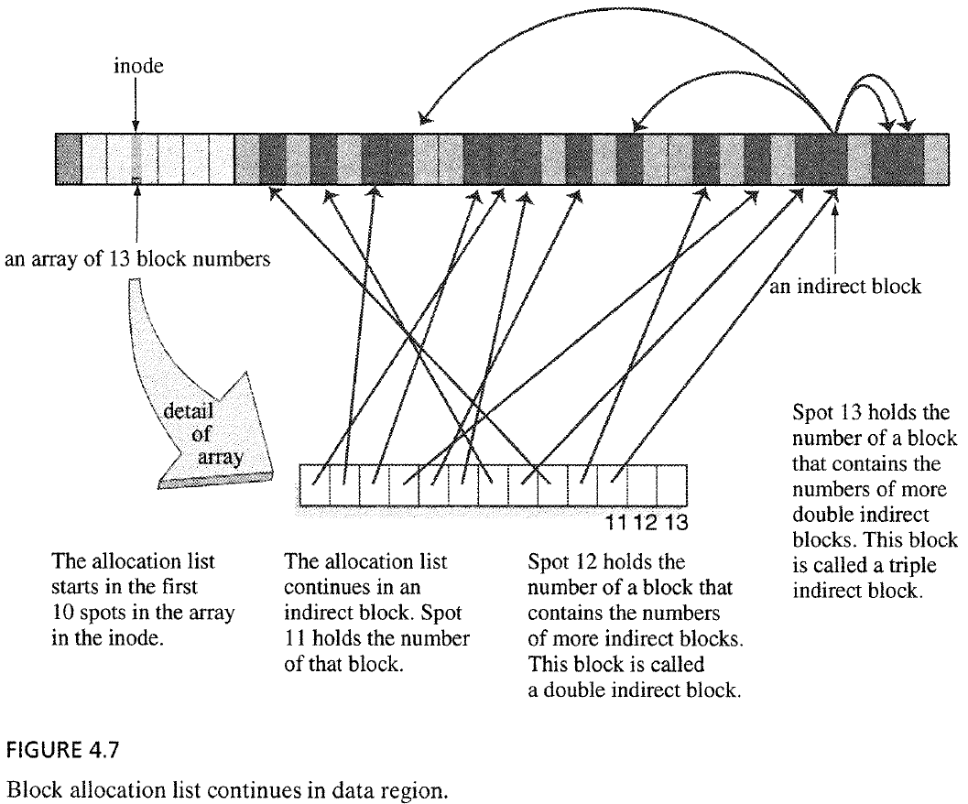
Inodes and Big Files
Notes:
What happens when the indirect block fills? What happens when the double indirect block fills? What happens when the triple indirect block fills?
How many size are used for a file? (15 entries)
0~11 : direct blocks (12 x 4KB = 48KB, 1block = 4KB)
4KB / 4byte = 1024 pointer/block
12 : indirect block (4KB x 1024 = 4MB)
13 : double indirect block (4KB x 1024 x 1024 = 4GB)
14 : triple indirect block (4KB x 1024 x 1024 x 1024 = 4TB)

Slide 25
Inodes and Big Files
What happens when the indirect block is full?
As more bytes are added to the file, kernel allocates more data blocks → allocation list gets longer and requires more storage
When the allocation list overflows the indirect block,
Kernel stores the block number of a block (called a double indirect block), which contains a list of the indirect blocks, in 12th spot in the inode
inode
Attributes
Data
Block
Indirect block
Double indirect block

Slide 26
Inodes and Big Files
What happens when the double indirect block is full?
Kernel creates new double indirect blocks
Kernel creates a triple indirect block to hold the block numbers of the new double indirect blocks
The block number of the triple indirect block is stored in the last spot of the allocation array in the inode
inode
Attributes
Data
Block
Indirect block
Double indirect block
Triple indirect block

Slide 27
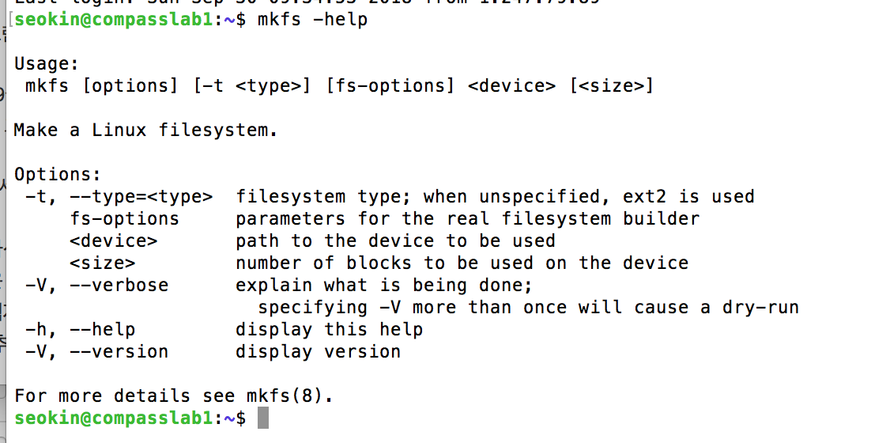
Inodes and Big Files
What happens when the triple indirect block is full?
The file has reached its limit
If we want to use really big files, we need to set up a file system with larger blocks.
When we create the file system, we can specify the size of block
A block might be one sector (512 Bytes) or it might be several sectors

Slide 28
Locating data block in ext2
The ext2 file system stores data blocks of a file in a set of pointers in the i-node
15 pointers
The first 12: direct pointer to the data blocks
The 13th pointer: points to the pointer block
pointer block holds 256 to 1024 pointers (1K to 4K block size)
The 14th pointer: double indirect pointer
The 15th pointer: triple indirect pointer
Benefits
Fixed-size i-node structure, but supports arbitrary file sizes
Allows to store data in noncontiguous blocks
For small files, they are accessed quickly through direct pointers
Allows enormous file sizes: 4TB

Slide 29
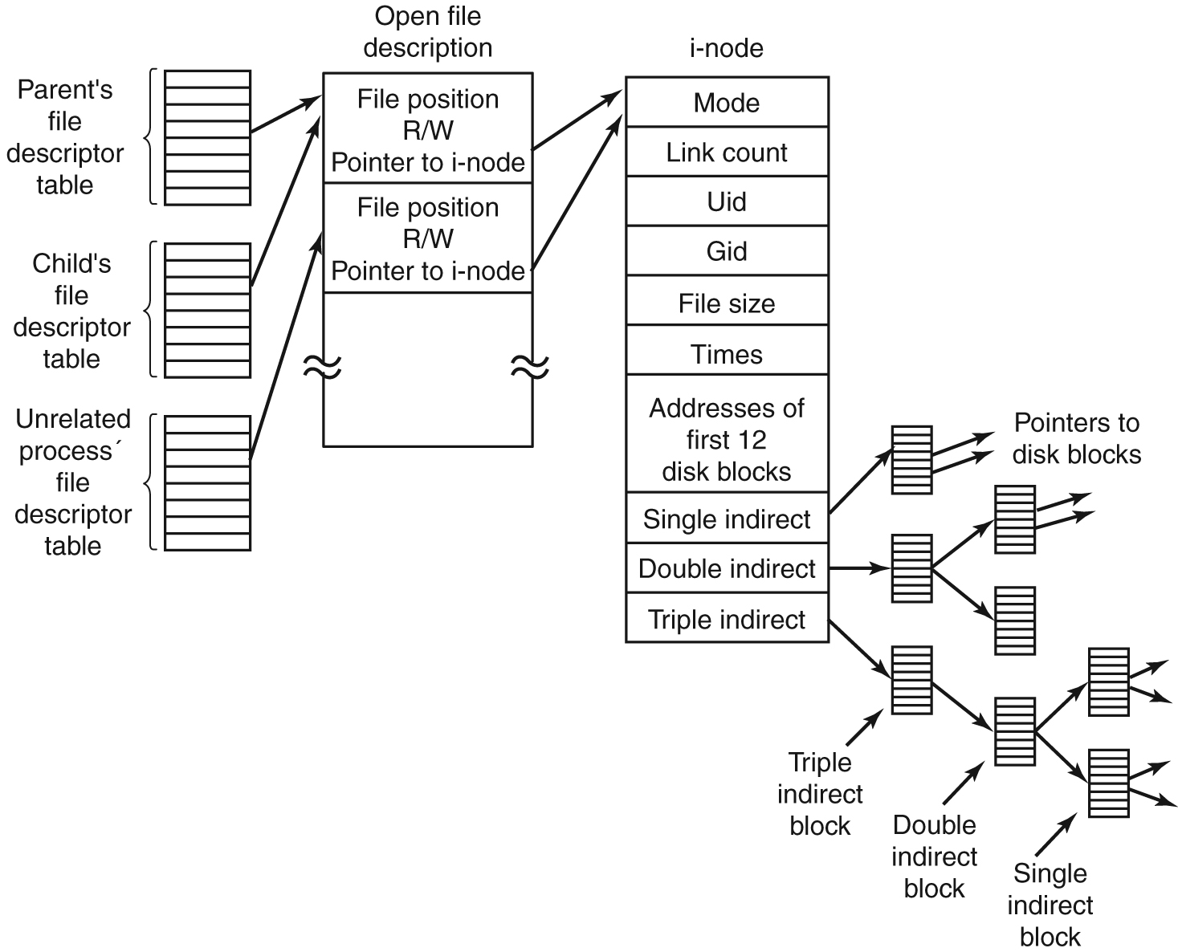
Data Structure for File Handling
File descriptor table
File descriptor table
per-process
contains a pointer to a file table entry
File table
per-system
the number of File descriptors pointing to this entry
contains
a pointer to the inode
file position
Access mode (read or write)
inode table
per-file
contains inode
File Table
inode table
Disk
inode
….
….
…
…

Slide 30
Data Structure for File Handling
When a process opens a file twice
File descriptor table
Open File Table
inode table
File descriptor
File description
inode

Slide 31
Data Structure for File Handling
When two processes open a file
File descriptor table
Open File Table
inode table
File descriptor
File description
inode
File descriptor

Slide 32
Data Structure for File Handling
When a process opens a file twice – exercise $ echo 123456789 > file
$gcc file_ex.c –o file_ex
$./file_ex file
file_ex.c
#include "unistd.h"
#include "fcntl.h"
#include "stdio.h"
int main(int argc,char **argv)
{
int fd1 = 0, fd2=0;
char buf[10+1]="";
if(argc != 2) {
fprintf(stderr,"usage: %s [file name]\n",argv[0]);
return 1;
}
fd1= open(argv[1],O_RDONLY);
if(fd1 == -1){
perror("failed open ");
return 1;
}
fd2= open(argv[1],O_RDONLY);
if(fd2 == -1){
perror("failed open 2");
return 1;
}
read(fd1,buf,4);
printf("fd1:%s\n",buf);
read(fd2,buf,4);
printf("fd2:%s\n",buf);
read(fd1,buf,4);
printf("fd1:%s\n",buf);
close(fd1);
close(fd2);
return 0;
}

Slide 33
Contents
4.2 User's View of File System
4.3 Internal Structure of Unix File System
4.4 Understanding Directories
4.5 Writing pwd
4.6 Multiple File Systems: A Tree of Trees

Slide 34
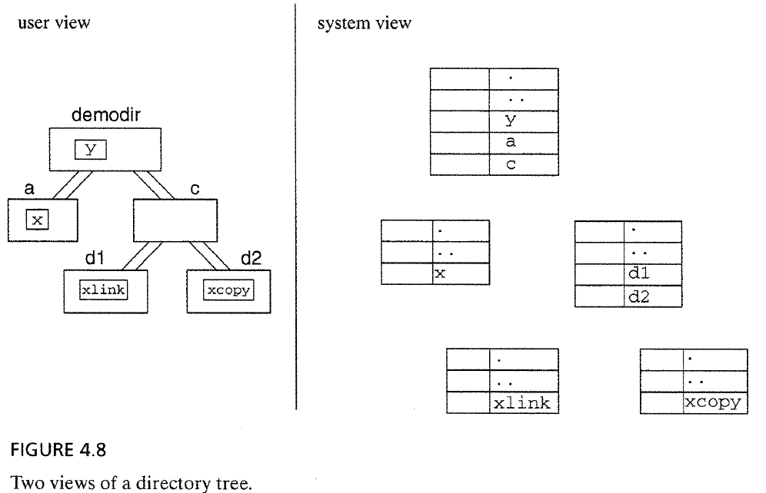
Understanding Directory Structure
Users see the file system as a collection of directories, subdirectories, and files
Internally, a directory is a file that contains filename and inode number
Notes:
Internally, a directory is a file that contains filename and inode #

Slide 35
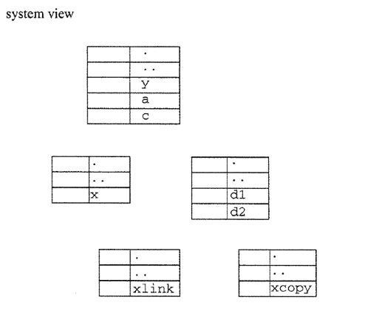
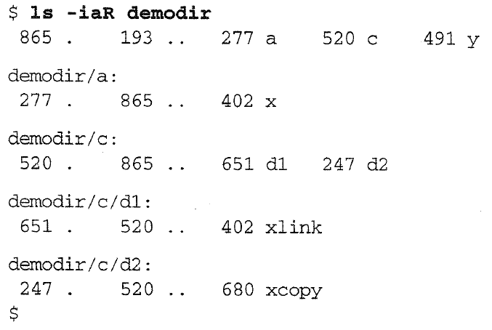
How can we translate from one diagram to the other?
Let’s fill the inode number in the system view diagram.

Slide 36
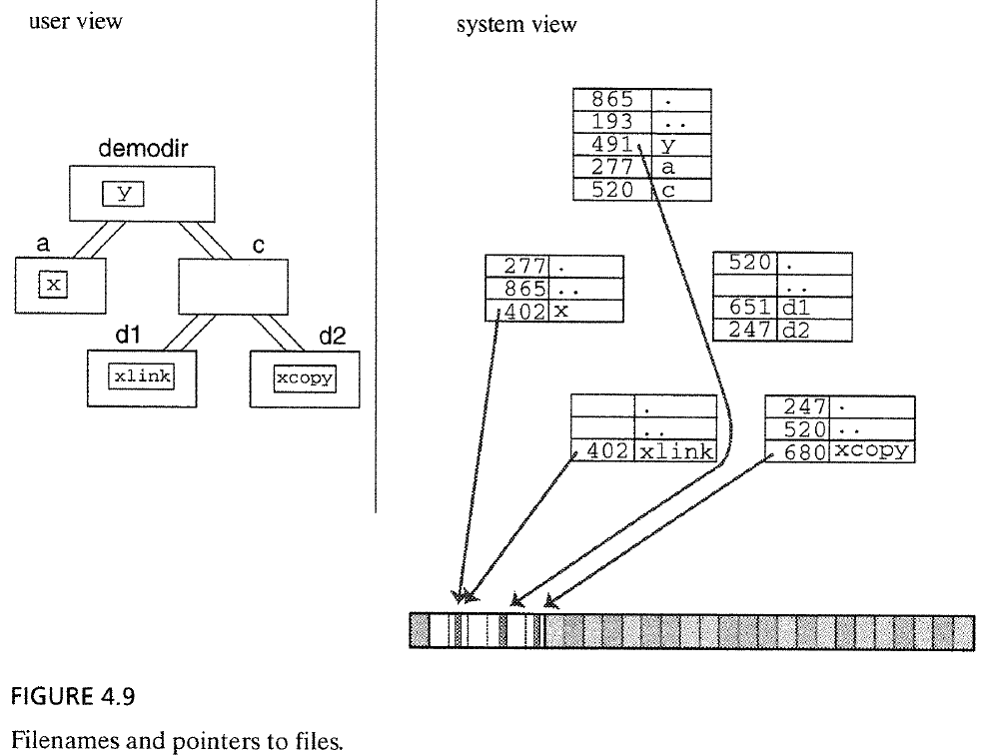
How can we translate from one diagram to the other?
Let’s fill the inode number in the system view diagram.

Slide 37
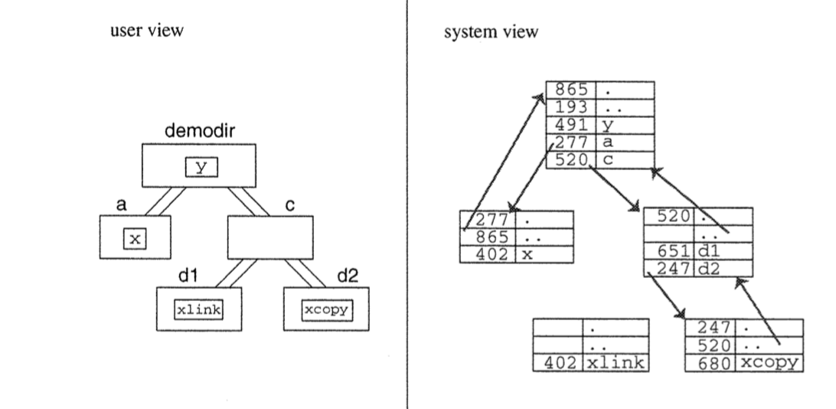
Real Meaning of “A file is in a directory”
In the system view, we see the directory contains an entry with filename “y” and inode number 491
“file x is in directory a” means,
there is a link to inode 402 in the directory called “a”, and the filename attached to that link is “x”
In short,
Directories contain references to files, each of these reference is called a link.
The content of the file are in data blocks
The properties of the file are recorded in an inode struct in the inode table
The inode number and a name are stored in a directory
865
Notes:
There is a link to inode 402 in the directory a, and the filename attached to that link is x
In short, directories contain references to files.
Each of these references is called a link.

Slide 38
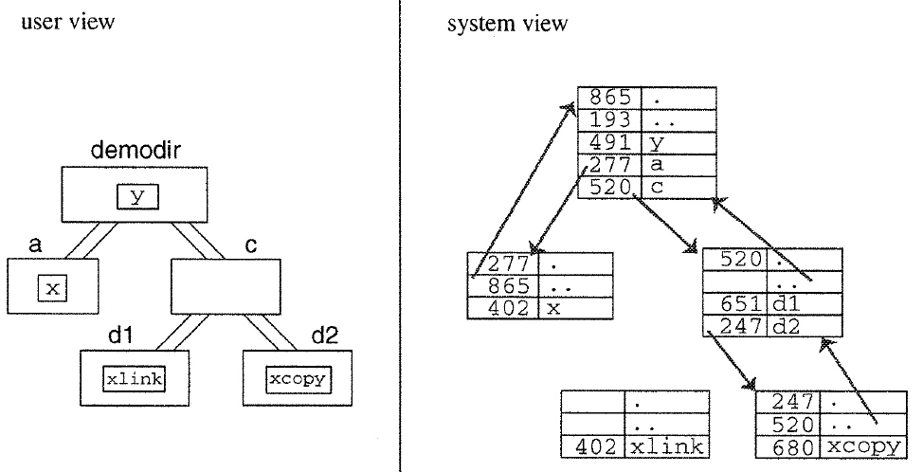
Real Meaning of “A directory contains a subdirectory”
The directory called “c” is a subdirectory of the “demodir” directory
→ means that demodir contains a link to the inode for that subdirectory
Kernel installs an entry (.) for its own inode in every directory
865
Notes:
dir contains a link to the inode for that subdir

Slide 39
Real Meaning of “A directory has a parent directory”
The directory called “d2” has a parent directory
→ means that “d2” contains a link to the inode for the parent directory
A directory contains a link (inode number) for the parent directory named “..”
Kernel installs an entry (..) for its parent directory in every directory
865
Notes:
dir contains a link to the inode for that subdir

Slide 40
Multiple Links, Link Counts
inode 402 has two links.
The two links (called hard link) refer the same inode
The file is an inode and a bunch of data blocks; a link is a reference to an inode. We can make as many links to a file as you like
Kernel records the number of links in the inode. The link count is one of members of the struct stat returned by the stat system call.
651
520
Notes:
one is the original file and which is the link to it?
In Unix, these two links have the same status; called hard links to the file

Slide 41
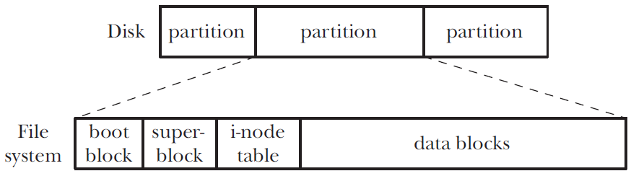
Directories and (Hard) Links
Characteristics of directory
Marked with a different file type in the i-node
A file with special organization: a table of filenames and i-node numbers
i-node
number
root directory (/)
UID=root
GID=root
2
type=directory
perm=rw-r-xr-x
…
/ directory
Data block pointers
…
…
tmp
5
…
…
etc
7
7
UID=root
GID=root
…
…
type=directory
perm=rw-r-xr-x
/etc directory
…
…
…
Data block pointers
group
282
…
…
passwd
6422
…
…
6422
UID=root
GID=root
type=directory
/etc/passwd file
perm=rw-r-xr-x
File data (login account information)
…
Data block pointers

Slide 42
Directories and (Hard) Links
We can create multiple files that point to the same i-node → hard link
$ echo -n 'It is good to collect things,' > abc
$ ls -li abc
122232 -rw-r--r-- 1 mtk users 29 Jun 15 17:07 abc
$ ln abc xyz
$ echo ' but it is better to go on walks.' >> xyz
$ cat abc
It is good to collect things, but it is better to go on walks.
$ ls -li abc xyz
122232 -rw-r--r-- 2 mtk users 63 Jun 15 17:07 abc
122232 -rw-r--r-- 2 mtk users 63 Jun 15 17:07 xyz

Slide 43
Navigating to a File in a Directory
Directory is special file that has a table with filename and i-node number
Example using /etc/password
/
etc
i-node
number
2
UID=root
GID=root
type=directory
password
perm=rw-r-xr-x
…
/ directory
Data block pointers
…
…
tmp
5
…
…
etc
7
7
UID=root
GID=root
…
…
type=directory
perm=rw-r-xr-x
/etc directory
…
…
…
Data block pointers
group
282
…
…
password
6422
…
…
6422
UID=root
GID=root
type=file
/etc/passwd file
perm=rw-r-xr-x
File data (login account information)
…
Data block pointers
Inode table

Slide 44
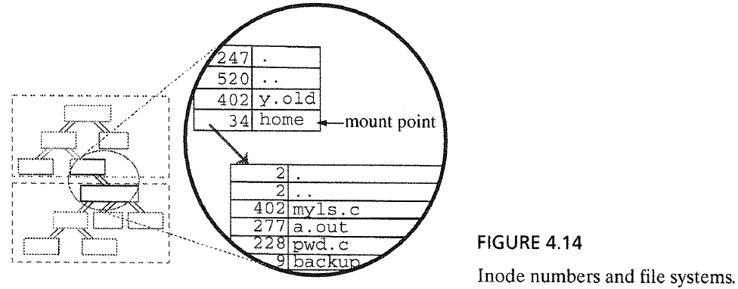
Limitation of Hard Links
Problem: we cannot make links (hard link) to the same file from different file systems.
This is because each file system has its own i-node table, so sharing i-nodes using i-node numbers will not work
Notes:
Are these links to the same file?

Slide 45
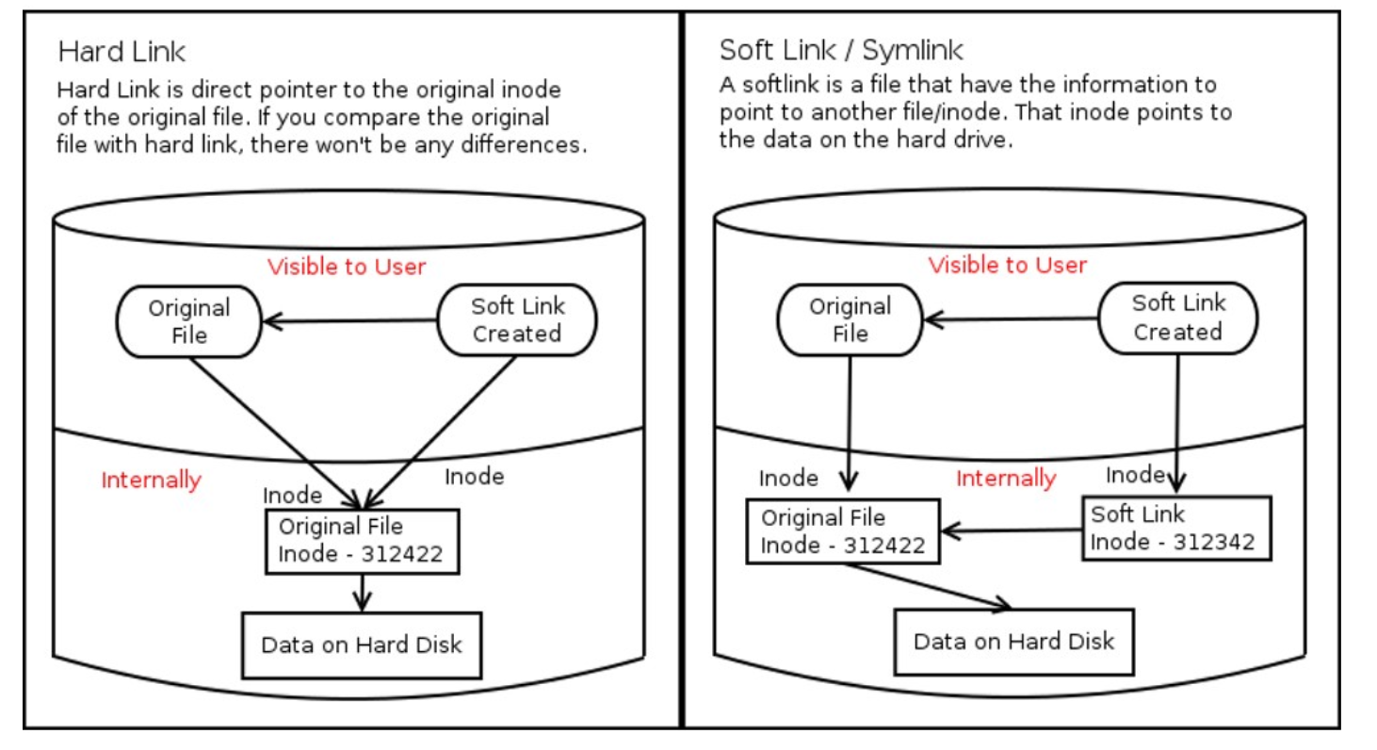
Symbolic Links
To point to directories or to files on other file systems, Unix supports another kind of link: symbolic link
A symbolic link refers to a file by name, not by i-node number
A symbolic link points to different i-node through the link data
A symbolic link has its own i-node
Hard link
Symbolic link
Notes:
Each hard linked file is assigned the same Inode value as the original, therefore they reference the same physical file location.
Removing any link, just reduces the link count, but doesn’t affect other links.

Slide 46
Symbolic (Soft) Links
Soft links
special file whose data is the name of another file
I-node table
/home/erena directory
i-node
number
61
UID=erena
GID=users
…
…
type=file
this
61
perm=rw-r--r--
…
…
/home/allyn directory
two hard links to
the same file
link count=2
size=518
…
…
…
that
61
Data block pointers
…
…
regular file
file data
309
UID=kiran
GID=users
/home/kiran directory
type=symlink
…
…
perm=rwxrwxrwx
other
309
a symbolic link
link count=1
size=16
…
…
…
data for soft link
Data block pointers
“/home/erena/this”

Slide 47
Hard link vs Symbolic link
Hard link
Pros
Deleting the original file does not cause the link to break or the content to disappear.
No separate inode is required as it is shared between the links
Cons
Cannot make a link across file systems.
Cannot make a link for a directory
Symbolic link
Pros
Can create symbolic links to almost all file system objects including files, directories, devices, and etc.
Links can be created across file systems and even across disks or mounts.
Can have different metadata such as file permissions for the symbolic link
Cons
Deleting or moving the files causes the symbolic links to break.
Some softwares do not work with symbolic links
Consume more storage space because it requires its dedicated inode and data block
Notes:
A soft link is similar to the file shortcut feature which is used in WindowsOS
As similar to hard links, any changes to the data in either file is reflected in the other.
if the original file is deleted or moved, the soft linked file will not work correctly

Slide 48
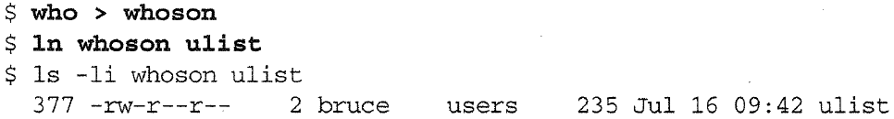
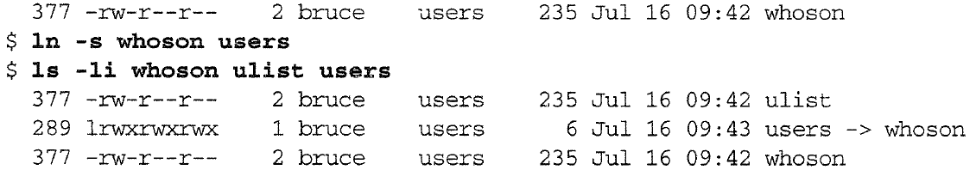
Hard link vs Symbolic link
Hard link
Symbolic link
※ makes a hard link ulist
Same inode and properties!
※ makes a symbolic link users
File type l(el) is a symbolic link
Different inodes and properties from original file!
Notes:
A soft link is similar to the file shortcut feature which is used in WindowsOS
As similar to hard links, any changes to the data in either file is reflected in the other.
if the original file is deleted or moved, the soft linked file will not work correctly

Slide 49
Commands and System Calls for Directory Trees
mkdir : Creates new directories
Uses mkdir() system call
mkdir() creates and links a new dir node to the directory tree;
creates the inode for the directory;
allocates a disk block for its contents;
installs the two entries in the directory: .(dot) and ..(dotdot) with inode numbers
adds a link to that node to its parent directory.
Notes:
internal structure of Unix FS is simple; it is a big linked data structure
nodes are called inodes,
sets of pointers are called directories,
leaf nodes are called files
we manage this tree with standard Unix commands such as mkdir, rmdir, mv, ln, and rm.
How do these commands work?
what system calls do they use?

Slide 50
Commands and System Calls for Directory Trees
rmdir : Deletes a directory
Uses rmdir()system call:
rmdir() removes a dir node from the directory tree.
The directory must be empty
The link to the directory is removed from its parent directory
If the directory itself is not in use by another process, the inode and data blocks are freed.
Notes:
rmdir system call removes a directory node from a directory tree.
The directory must be empty.
That is, apart from the entries for dot and for dotdot, the directory may not contain an files or subdirectories.
The link to the directory is removed from its parent directory.
If the directory itself is not in use by another process, the inode and data blocks are freed.
unlink deletes a directory entry.
It decrements the link count for the corresponding inode.
If the link count for the inode becomes zero, the data blocks and inode are freed.
If there are other links to the inode, the data blocks and inode are otherwise untouched.
un1nk may not be used to unlink directories.

Slide 51
Commands and System Calls for Directory Trees
rm : Removes entries from a directory
Uses unlink() system call
unlink() deletes a directory entry;
It decrements the link count for the corresponding inode.
If the link count for the inode becomes zero, the data blocks and inode are freed.
Notes:
rmdir system call removes a directory node from a directory tree.
The directory must be empty.
That is, apart from the entries for dot and for dotdot, the directory may not contain an files or subdirectories.
The link to the directory is removed from its parent directory.
If the directory itself is not in use by another process, the inode and data blocks are freed.
unlink deletes a directory entry.
It decrements the link count for the corresponding inode.
If the link count for the inode becomes zero, the data blocks and inode are freed.
If there are other links to the inode, the data blocks and inode are otherwise untouched.
un1nk may not be used to unlink directories.

Slide 52
Commands and System Calls for Directory Trees
ln : Creates a link to a file
Uses link() system call:
link() makes a new link to an inode.
The new link contains the inode number of the original link and has the name specified.
Notes:
link makes a new link to an inode.
The new link contains the inode number of the original link and has the name specified.
If there is already a link with the new name, link will fail.
Nobody is allowed to use link to make new links to directories.
rename system call changes the name or location of a file or directory.
rename("y","y.old")changes the name of the file.
rename("y","c/d2/y.old") changes the name and the location of the file.
rename can be also used for directories.
You may not move a directory into one of its subdirectories.

Slide 53
Commands and System Calls for Directory Trees
mv : Changes the name or location of a file or directory
Uses rename() system call
rename("y","y.old") changes the name of the file.
rename("y","c/d2/y.old") changes the name and the location of the file.
rename can be also used for directories.
Notes:
link makes a new link to an inode.
The new link contains the inode number of the original link and has the name specified.
If there is already a link with the new name, link will fail.
Nobody is allowed to use link to make new links to directories.
rename system call changes the name or location of a file or directory.
rename("y","y.old")changes the name of the file.
rename("y","c/d2/y.old") changes the name and the location of the file.
rename can be also used for directories.
You may not move a directory into one of its subdirectories.

Slide 54
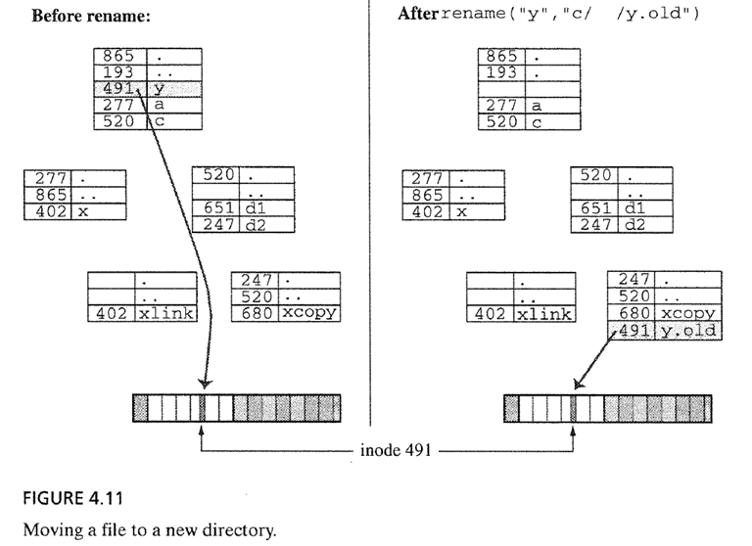
Commands and System Calls for Directory Trees
How does rename move a file to another directory?
Files are not really in directories, links to files are in directories
rename() moves the link from one directory to another
Step 1. Copy original link to new name and/or location
Step 2. Delete original link
d2
Notes:
Files are not really in directories,
links to files are in directories.
rename moves the link from one dir to another.

Slide 55
Commands and System Calls for Directory Trees
cd : Changes the current directory of a process
Uses the chdir() system call
Each running program on Unix has a current directory;
Internally, process keeps a variable that stores the inode number of the current directory
Notes:
what is the inode number of your current directory?
$cd d1
what is the inode number of your current directory?
$cd ../..
what is the inode number of your current directory

Slide 56
Contents
4.2 User's View of File System
4.3 Internal Structure of Unix File System
4.4 Understanding Directories
4.5 Writing pwd
4.6 Multiple File Systems: A Tree of Trees

Slide 57
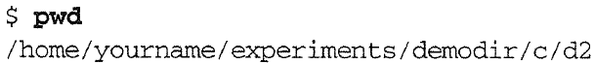
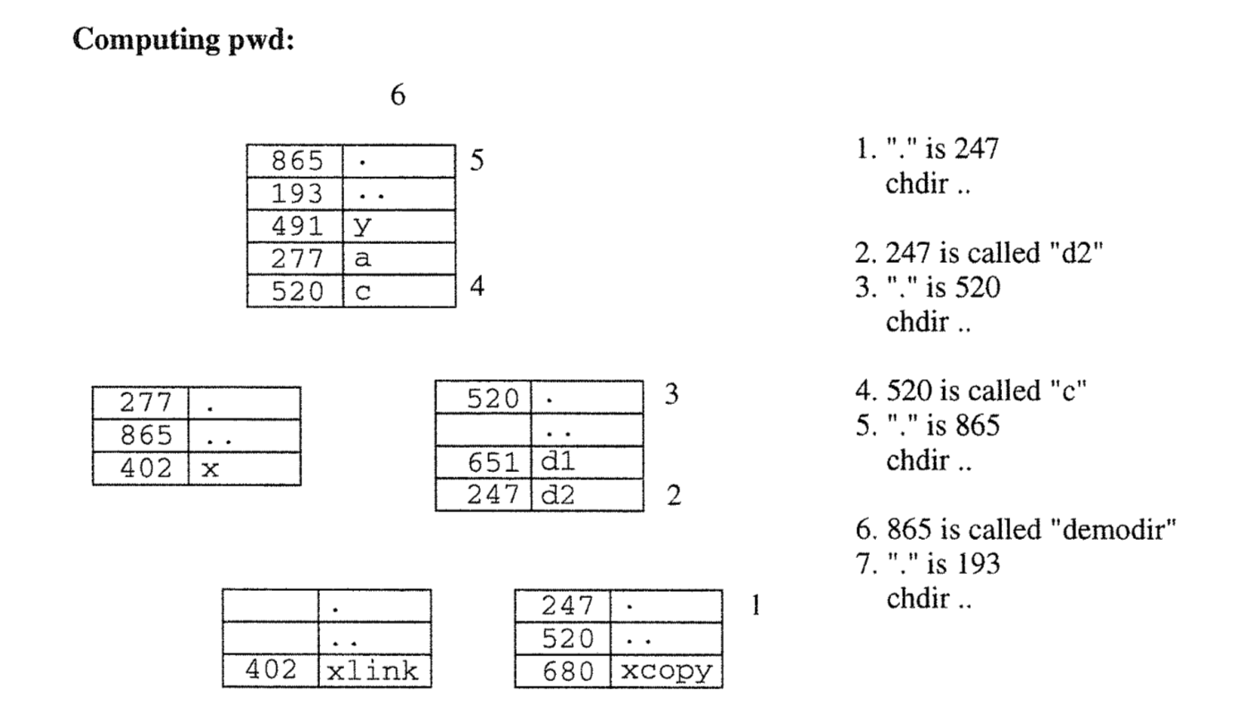

How pwd Works
pwd : prints the path to the current directory
How?
follows the links and read the directories by climbing up the directory tree until it reaches the top of the tree
Algorithm
1. Get the inode number (say, n) for “.”
2. Go to the parent directory with chdir() system call
3. Find the name for the link with inode n
Repeat 1~3 until you reach the top of the directory tree
Notes:
noting at each step the inode # for dot, and then
looking through the parent dir for the name assigned to that inode #, until it reaches the top of the tree

Slide 58
How pwd Works
Q1: How do we know when we reach the top of the tree?
In the root directory, “.” and “..” point to the same inode
repeat until it gets to a directory in which inode numbers for “.” and “..” are equal
Q2: How do we print the directory names in the correct order?
Make a recursive program that winds up to the top of the directory tree and prints the directory names, one by one, as it unwinds.

Slide 59
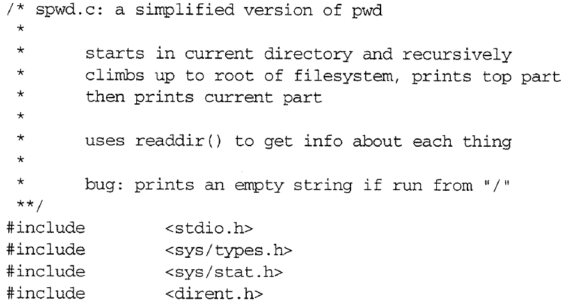
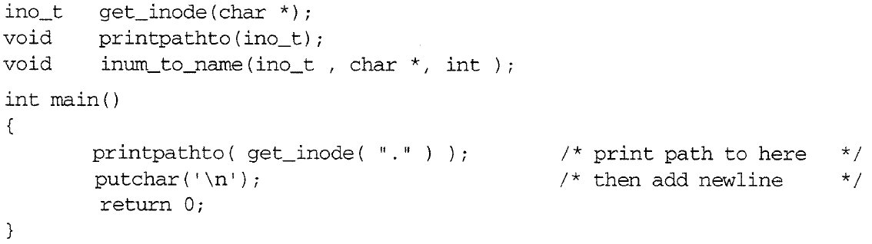
A Version of pwd: spwd.c
#include <stdlib.h>
#include <string.h>

Slide 60
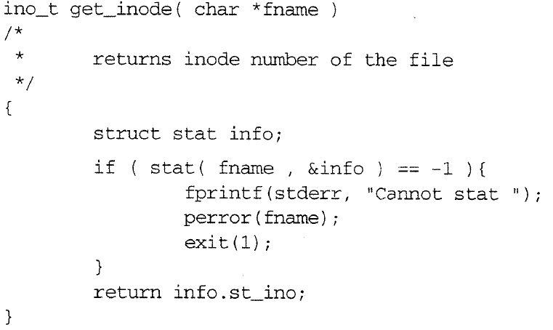
A Version of pwd: spwd.c

Slide 61
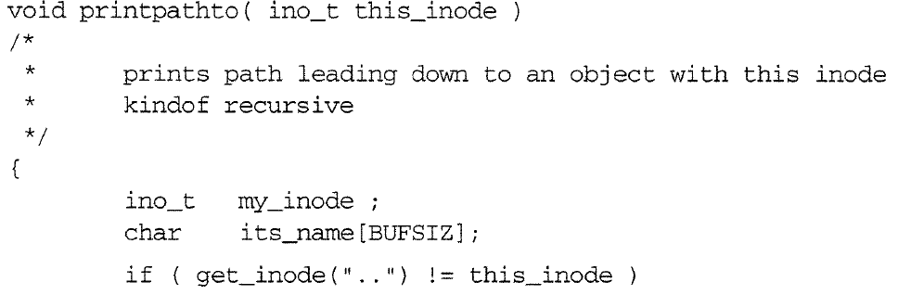
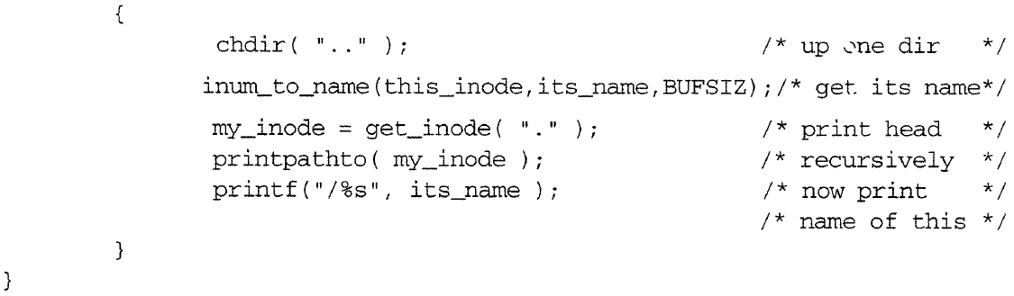
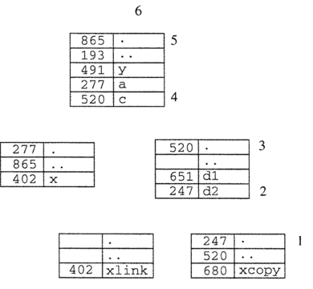
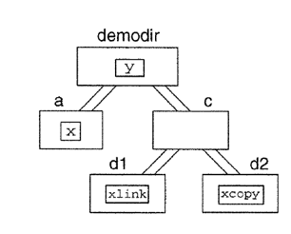
A Version of pwd: spwd.c

Slide 62
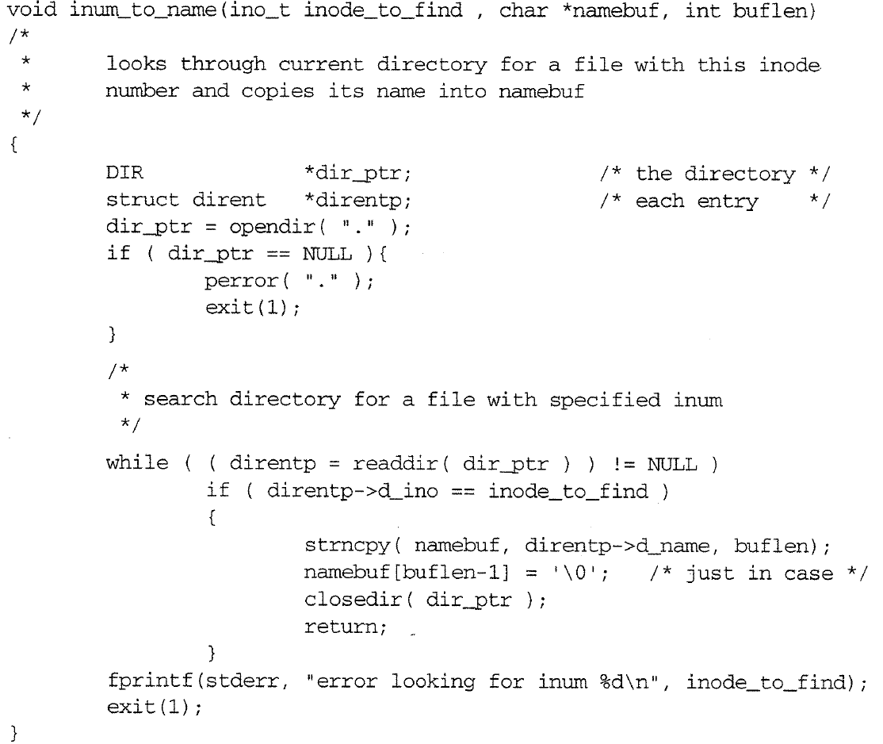
A Version of pwd: spwd.c
Notes:
p.78

Slide 63
Contents
4.2 User's View of File System
4.3 Internal Structure of Unix File System
4.4 Understanding Directories
4.5 Writing pwd
4.6 Multiple File Systems: A Tree of Trees

Slide 64
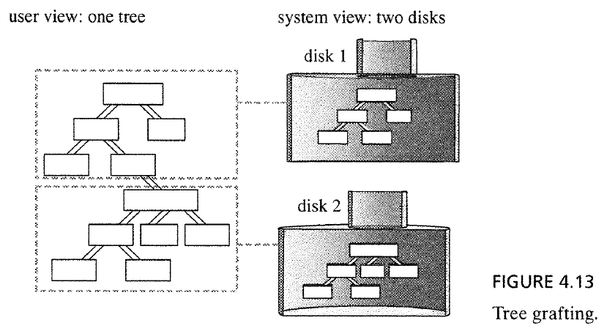
Multiple File System: a Tree of Trees
What if a system has two disks or partitions?
Approach 1 (e.g., Windows): assign drive letters to each disk or partition and use the letter for a part of the full path to a file
Approach 2: assign block numbers across all disks to create a virtual disk
Approach of Unix
Each disk/partition has its own file system tree.
When there is more than one file system on a computer, Unix provides a way to graft these trees into one larger tree.
User sees a seamless tree of directories even there are two trees (one on disk 1 and one on disk 2)
One file system is designated the root filesystem
The other file system is attached to some subdirectory of the root file system
Notes:
Graft: insert, join

Slide 65
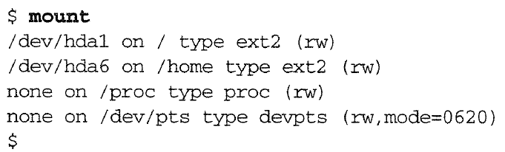
Mount Points
The directory to which the subtree is attached is called the mount point for that second file system.
mount : lists currently mounted file systems and their mount points
device name
file system
mount point
Notes:
The mount command lists currently mounted file systems and their mount points
ext2(second extended filesystem)
devpts is a virtual filesystem
The proc filesystem (procfs) is a special filesystem in Unix-like OS that presents information about processes and other system information in a hierarchical file-like structure,
providing a more convenient and standardized method for dynamically accessing process data held in the kernel than traditional tracing methods or direct access to kernel memory.

Slide 66
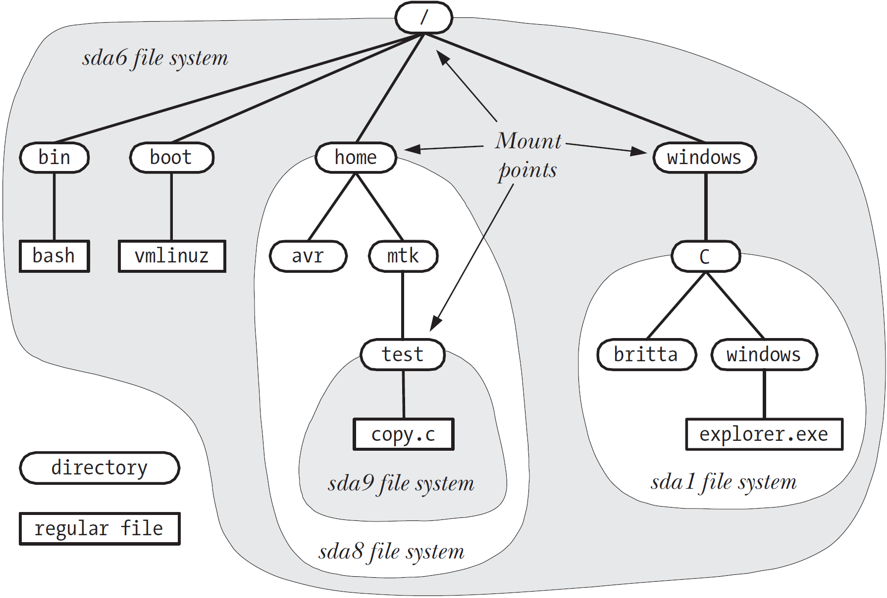
Example directory hierarchy

Slide 67
Summary
Unix organizes disk storage into file systems.
File system is a collection of files and directories.
Directory is a list of names and pointers. Each entry in a directory points to a file or directory
A Unix file system is comprised of three main parts : superblock, inode table, a data region.
File contents are stored in data blocks.
File attributes are stored in an inode. The position of the inode in the inode table is called the inode number of the file
The same inode number may appear in several directories with various names.
Each entry is called a hard link of a file.
A symbolic link is a link that refers a file by name instead of by inode number
Several file systems can be connected into one tree.
The kernel operation that connects a directory of one file system to the root file system is called mounting
Notes:
A soft link is similar to the file shortcut feature which is used in WindowsOS
As similar to hard links, any changes to the data in either file is reflected in the other.
if the original file is deleted or moved, the soft linked file will not work correctly

